Slide 1

Comprehensive Analysis of Superstore Sales Data
By Geetanjali

Slide 2
Overview of Dataset
Our analysis is based on a comprehensive superstore dataset that spans multiple years and regions. This dataset includes key columns such as Order ID, Order Date, Customer Name, Segment, City, State, Product Category, Sales, Quantity, Discount, and Profit. It provides a rich source of information for understanding sales trends, customer behavior, and product performance, helping to drive strategic business decisions.

Slide 3
Tasks and Visualizations
Construct a line chart showing the profit across different categories.
Visualize the profit across different ship modes.
Visualize the profit across different segments.
Construct a bar chart showing the sales across sub-categories.
Construct a doughnut chart to show the percentage of profit for different categories out of the total profit.
Create a bar chart to show the sum of quantity sold in California, Colorado, New York, and Arizona. Create a bar chart to show sales across different cities in Georgia State.

Slide 4
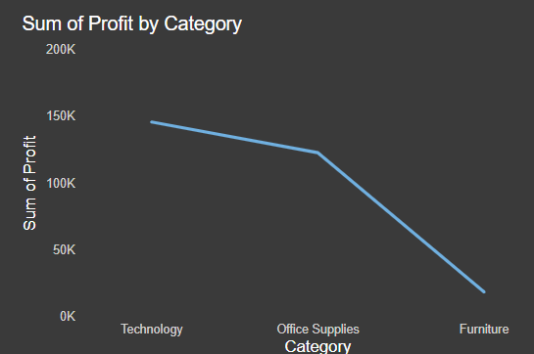
Profit Across Categories
The visual technology category shows the highest profit across all categories, highlighting its key role in driving the company’s overall profitability.

Slide 5
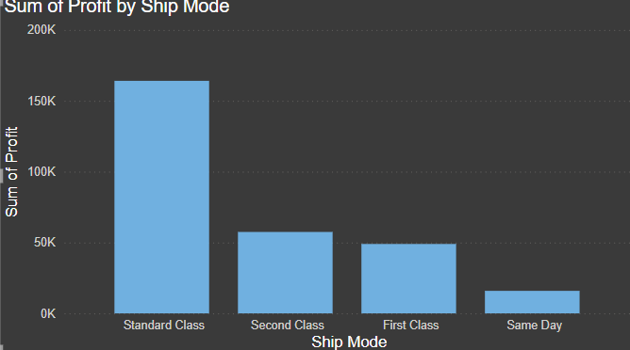
Profit Across Ship Modes
The Standard shipping mode achieves the highest profit compared to First Class, Second Class, and Same Day shipping options, demonstrating its superior profitability among the shipping methods.

Slide 6
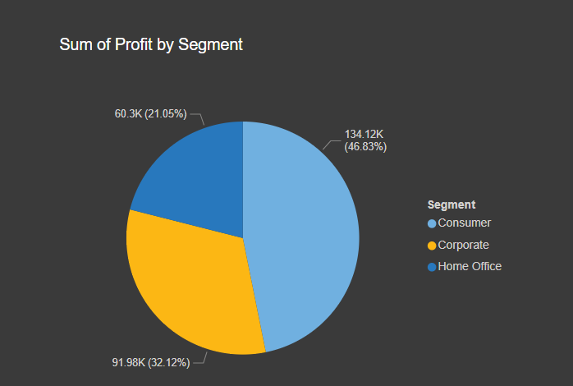
Profit Across Segments
Consumers drive the highest profit compared to home office and corporate segments.

Slide 7
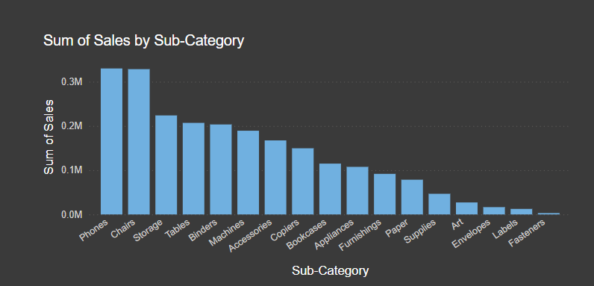
Sales Across Sub-Categories
Phones dominate sales across all sub-categories.

Slide 8
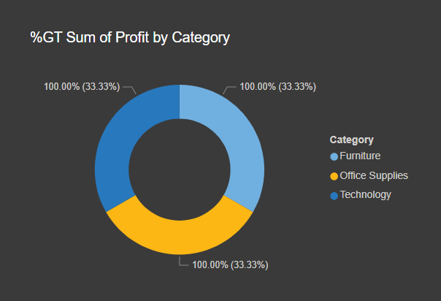
Percentage of Profit by Category
Profit is evenly distributed across all three categories.

Slide 9
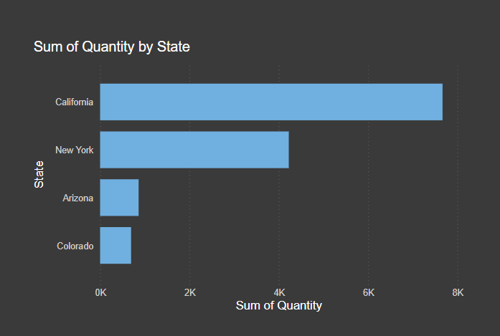
Quantity Sold in Selected States
California leads in quantity sold compared to Colorado, New York, and Arizona.

Slide 10
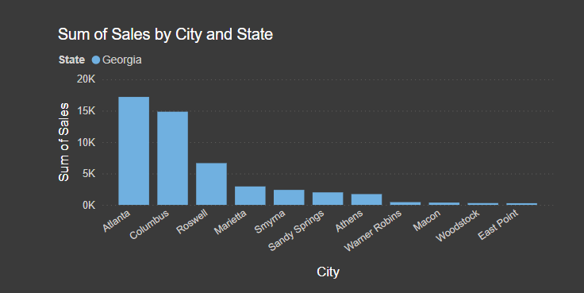
Sales Across Cities in Georgia
Atlanta outperforms other cities in Georgia State in terms of sales.

Slide 11
conclusion
Our analysis underscores the significance of consumer preferences and regional disparities in driving Superstore's performance. Phones emerge as a top-selling product category. These insights equip us to refine marketing strategies, optimize product offerings, and allocate resources effectively. By capitalizing on these findings, we can enhance customer satisfaction, boost sales, and solidify the Superstore's market position.

